Slide 1
My First Experience In Nairobi
“The Green City In The Sun”

Slide 2

Nairobi city

Slide 3
Climate Change
It was my very first time to step into Nairobi city all the way from Lodwar. At that time the city was experiencing moderate rainfall and pretty warm climate of which I found it so equable and easy to cope with as compared to where I had came from, where the climate was hot , windy ,mostly cloudy and virtually no rainfall during the year

Slide 4
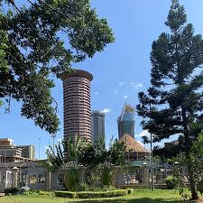
Kenyatta International Conference Centre

Slide 5
Amazing Garden In Nairobi
At Hilton Garden inn there’s an open ,inviting atmosphere with warm , sunny service . There thoughtful touches that make your stay easier and more comfortable, there’s a place for every mood example . the swimming pool for refreshment.

Slide 6

Hilton Garden Inn Nairobi

